Slide 1

Hari Chandana Datla
Lakshmi Chandana Shaik
Guided by Prof. Chaojie Wang
Summer 2022

Slide 2

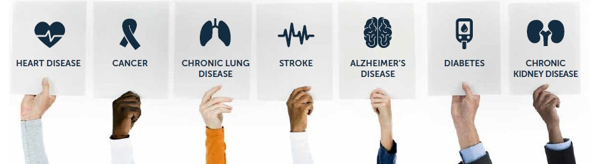
Introduction
Health occupies utmost priority in everyone’s life.
Falling prey of Chronic diseases.
Unhealthy behaviors and eating habits.
Looks into prevention.
How many are taking actions based on their health outcomes

Slide 3

Data Source
The source for this data is CDC(Centers for Disease Control and Prevention)., Division of Population Health, Epidemiology and Surveillance Branch and this project of making this dataset was funded by the Robert Wood Johnson Foundation (RWJF) in conjunction with the CDC Foundation.
Size of dataset is 224.276 MB.
The dataset has 810k rows and 24 columns.

Slide 4
Dataset
Contains health metrics for over 28,000 different census tracts within the 500 largest cities in America. It’s an awesome data-set because of the sheer quantity of locations included and also because of the amount of detailed structured data it contains for each of those very specific locations.
It includes columns such as State, city, population count, health measures, categories that the health measures fall into, Measure id, Category id and so on.

Slide 5
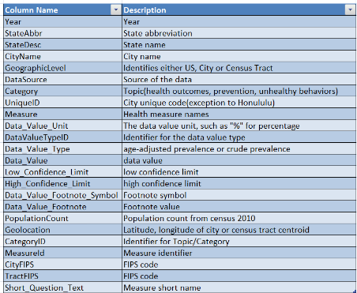
Dataset Columns
hgbugv

Slide 6
Aim & Purpose of Project
Helps in bring out the states that stand tall in their occurrence with respect to all the categories like Unhealthy behaviors, Prevention and Health outcomes.
The analytics could be helpful for Govt or private organizations in planning health care initiatives specific to a city or a region.

Slide 7
Literature Review
Pandas
Matplotlib
Machine learning libraries
Spark
Linear Regression
Lasso Regression
Ridge Regression
Decision Tree Classifier
Random Forest Classifier
Accuracy
Standard Deviation

Slide 8

Research Questions
The main objective is to analyze the unhealthy behaviors, health outcomes and prevention (3 variables) in the dataset and their relation with various health measures
Which cities are more into prevention?
Identifying which machine learning model gives the best accuracy score for our analysis.

Slide 9
Research Process
Data collection
Data cleaning
EDA
Data Visualization
ML models
Results

Slide 10
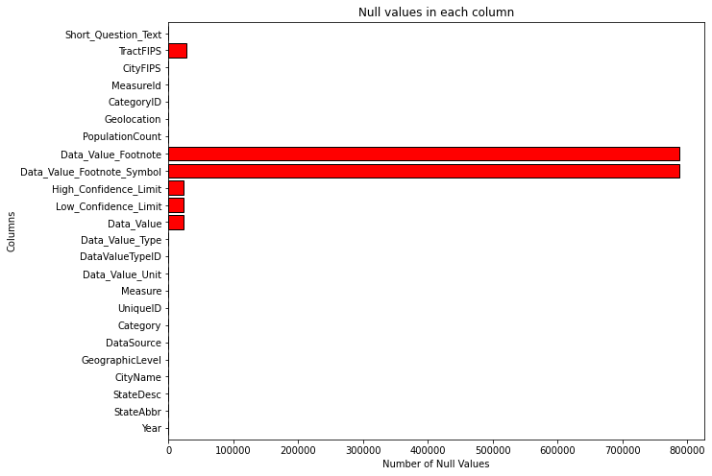
Data Cleaning
Checking for
Null values

Slide 11
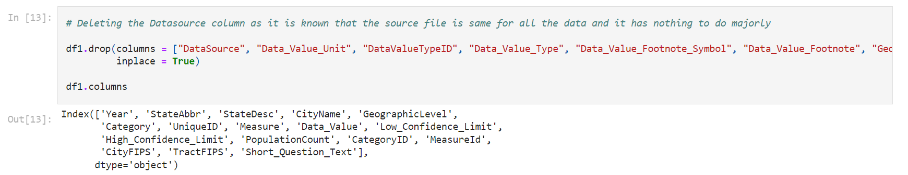
Data Cleaning
Removing columns that have no impact in our analysis

Slide 12
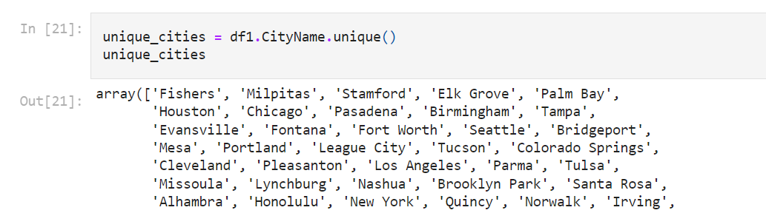
Data Preparation
Checking for unique cities. We are having more than 1 value for a city due to census tract data in the dataset.

Slide 13

Exploratory Data Analysis

Slide 14
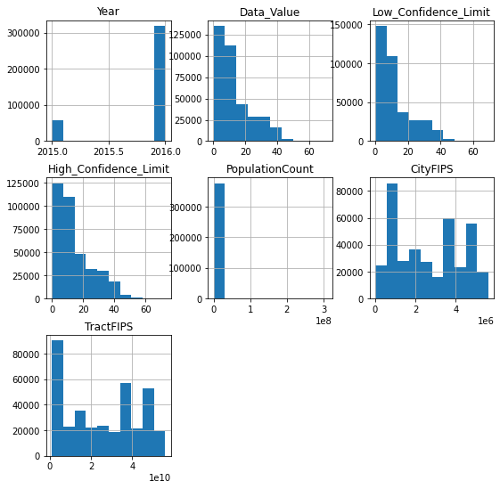
Grouping the features by target feature “CategoryID”
fv

Slide 15
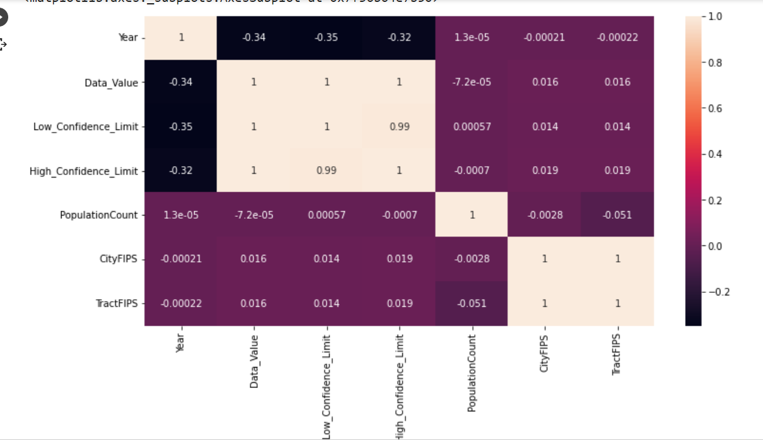
Correlation Matrix

Slide 16
abc
Data Visualization of New York data
file:///C:/Users/91951/Documents/MASTERS/DATA%20606/Downloaded%20Files/NY_info.html
Comparison after dividing the New York data into test and train datasets
file:///C:/Users/91951/Documents/MASTERS/DATA%20606/Downloaded%20Files/Compare.html

Slide 17
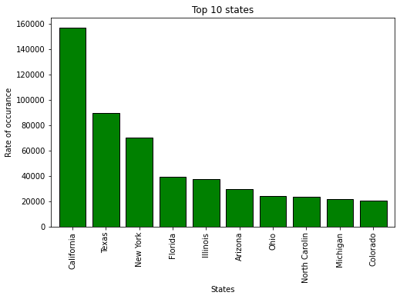
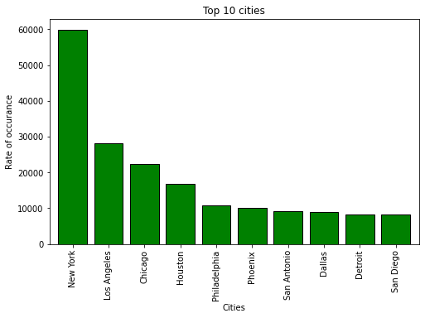
abc
Below are the States and Cities that ranked top 10 in our analysis.

Slide 18
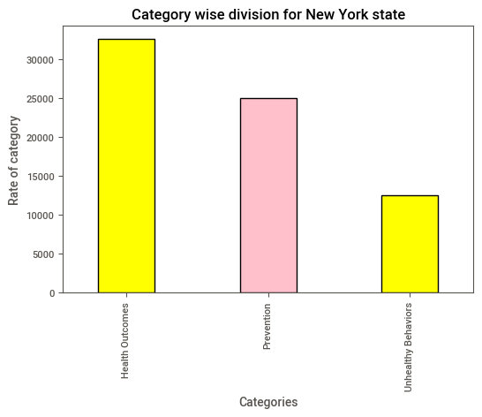
abc
Analysing New York Records

Slide 19
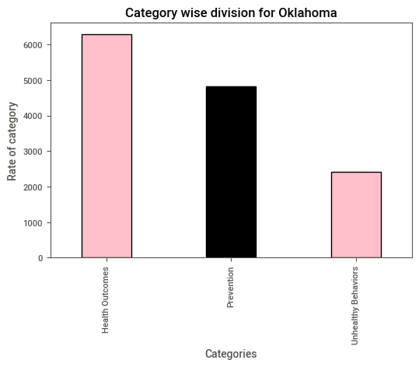
abc
Analysing Oklahoma Records

Slide 20
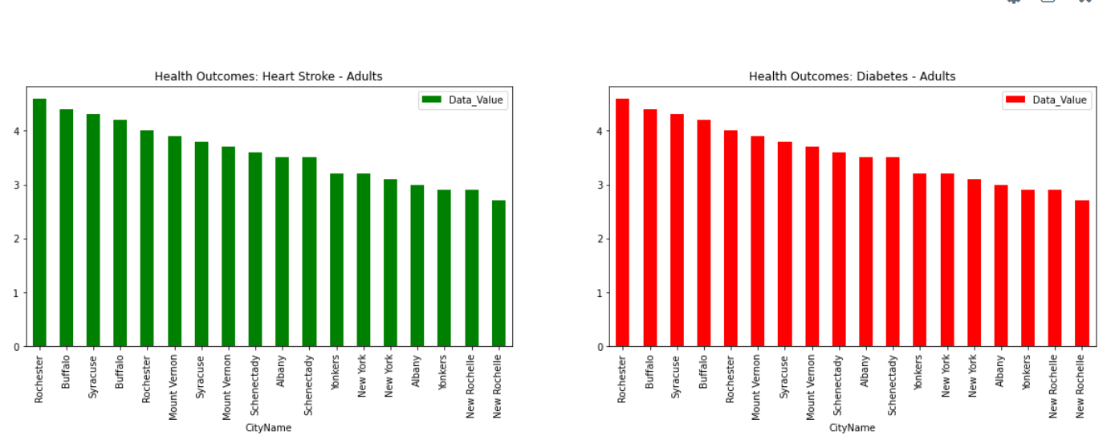
EDA for New york state
Heart Stroke and Diabetes prevalence.

Slide 21
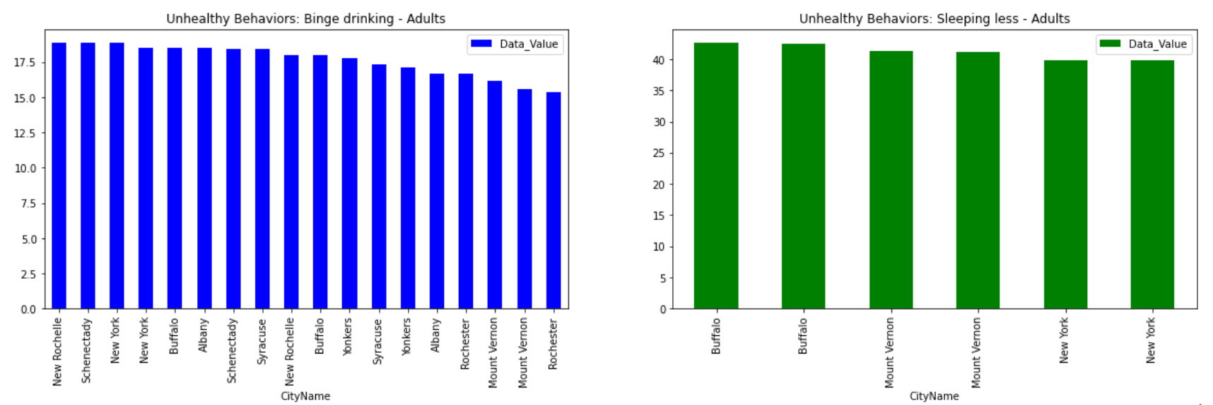
New york state- Prevalent unhealthy behaviors
Binge Drinking and sleep deprivation in adults.

Slide 22
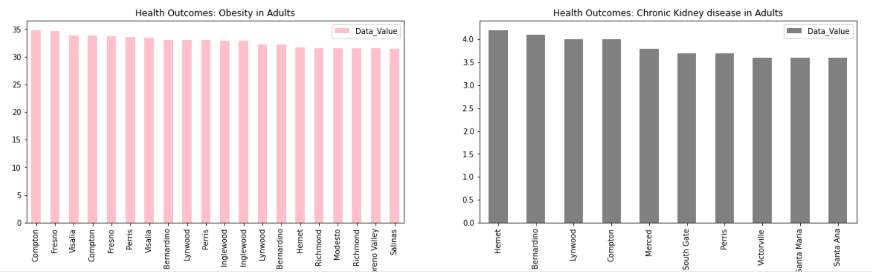
California State
Obesity and chronic kidney disease in adults.

Slide 23
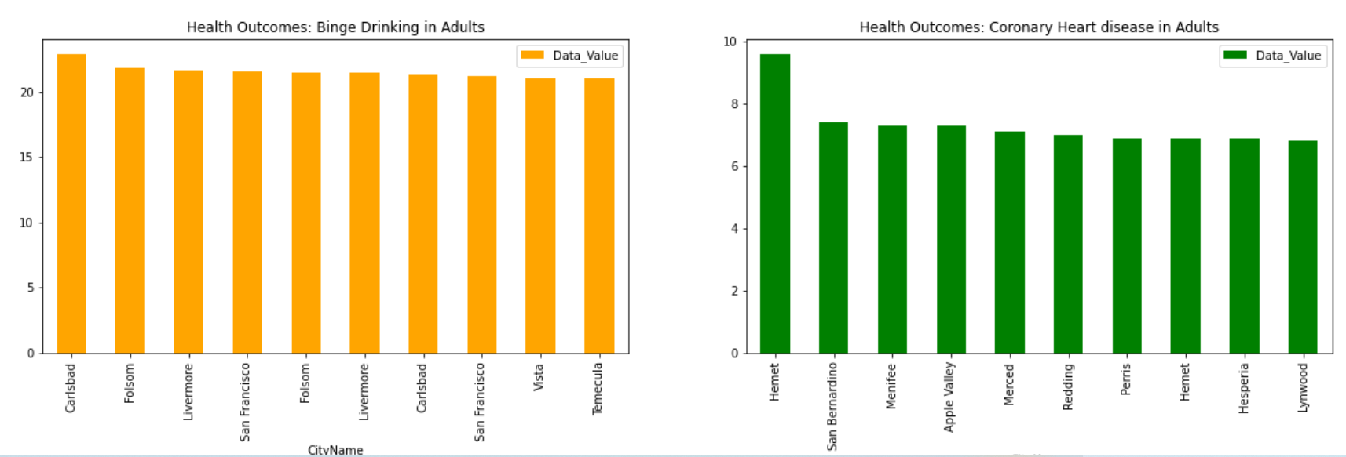
California State
Binge drinking and coronary heart disease in Adults.

Slide 24
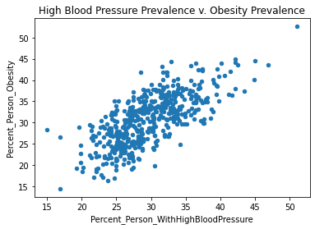
Relationship between high BP and obesity
cbd

Slide 25

Machine Learning
vgb

Slide 26
Machine Learning
Resampling the data
Data splitting
Training the models
Features used for training and encoding
Results

Slide 27
Dealing with Imbalanced Data
Matching the target classes is required because the model should give equal importance or weight to all the classes rather than being biased in detecting the majority class.
It is observed that the target class has an imbalance.

Slide 28
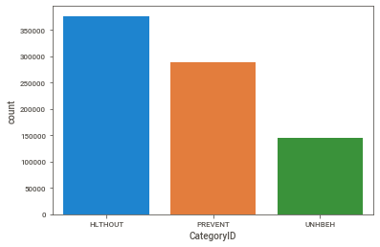
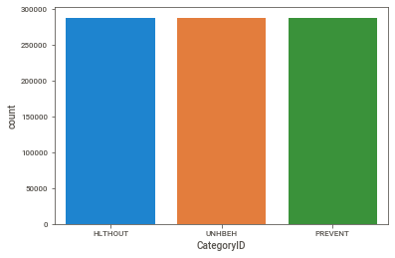
Resampling the Imbalanced Data
Before resampling After resampling

Slide 29
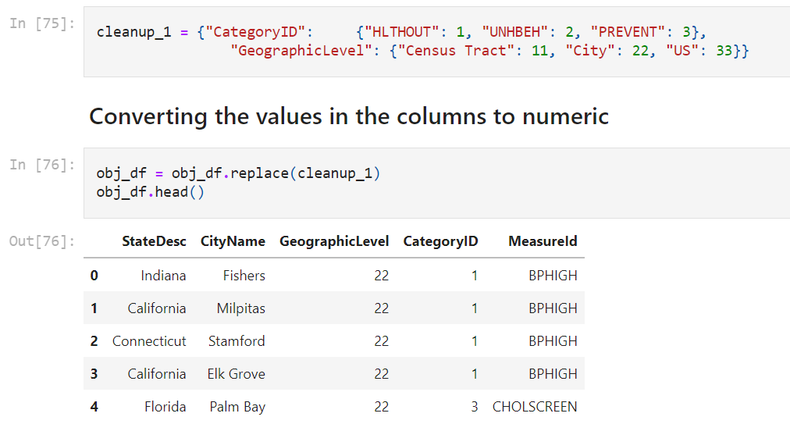
Encoding
We have encoded our target column values as shown in the following code snippet.

Slide 30
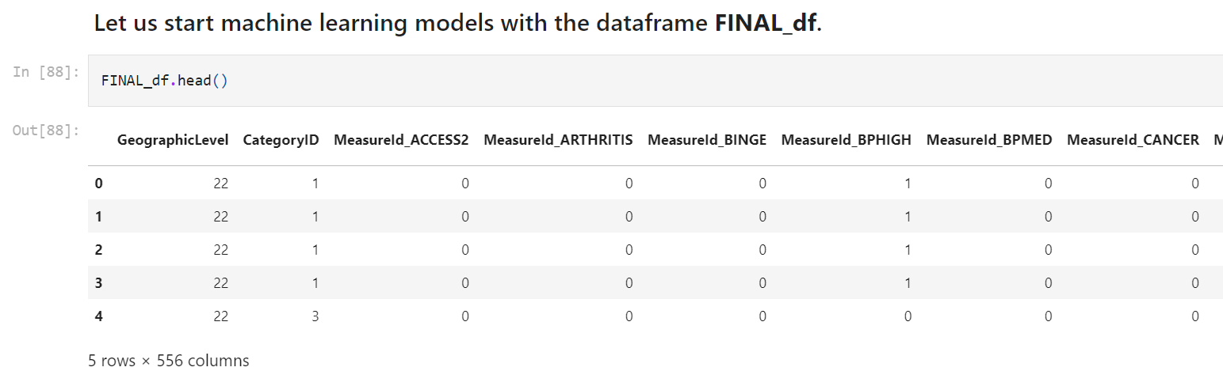
Encoded Dataset

Slide 31
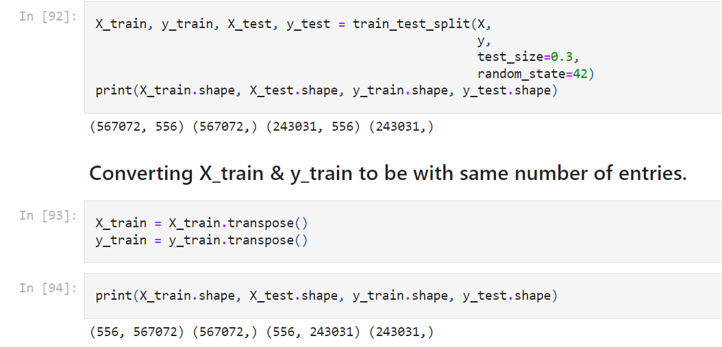
Training and Test Datasets

Slide 32
Machine Learning Models
Linear Regression
Ridge Regression
Lasso Regression
Decision Tree Classifier
Random Forest Classifier

Slide 33
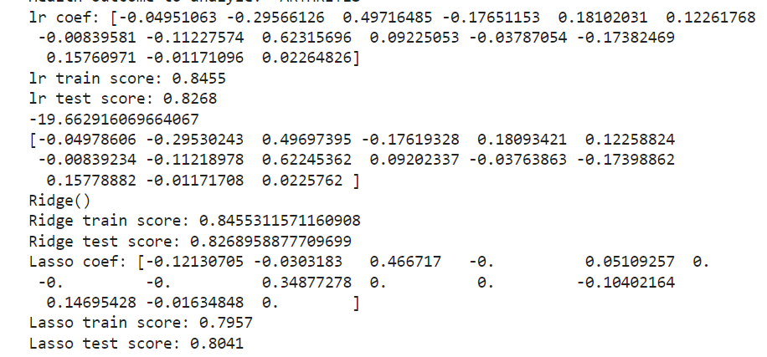
Regression Model results

Slide 34
Classification models results

Slide 35
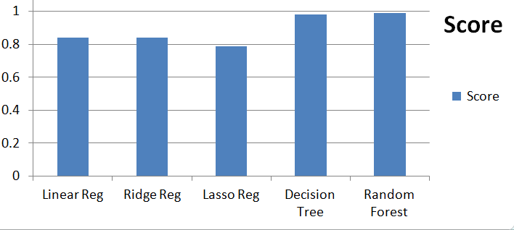
Performance of Machine learning models

Slide 36
Conclusions
Decision Tree classifier and Random Forest Classifier worked well for our dataset.
Generally, health outcomes topped up.
People are less into prevention.
Many people are into medications.

Slide 37
References
Link to GitHub:
https://github.com/HariChandana1116/harichandana_data606
YouTube : https://youtu.be/YFhMed2fZW8
Link to dataset:
https://chronicdata.cdc.gov/500-Cities-Places/500-Cities-Local-Data-for-Better-Health-2018-relea/rja3-32tc
https://towardsdatascience.com/whats-the-difference-between-linear-regression-lasso-ridge-and-elasticnet-8f997c60cf29

Slide 38

nh

